Slide 1
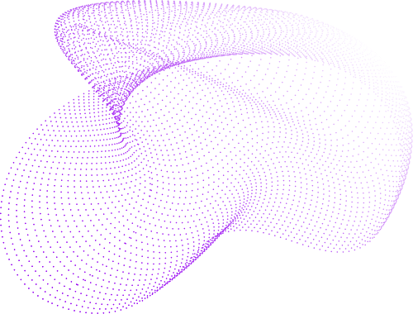

PCAI
PulmoCareAI
Lung Cancer Detection
Nisarg Trivedi
Powered by Deep Learning

Slide 2
PCAI
Agenda
Problem Statement & Medical Challange
Technologies used
Technical Architecture Overview
AI Model Architecture (ResNet50)
Complete System Workflow
Tip: Use links to go to a different page inside your presentation.
How: Highlight text, click on the link symbol on the toolbar, and select the page in your presentation you want to connect.
Security & Database Design
Performance Metrics & Medical Impact
Future Enhancement

Slide 3
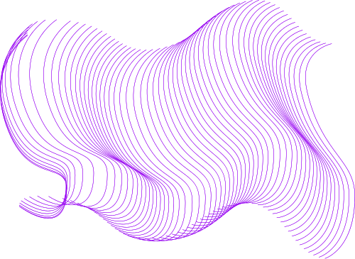


Problem Statement & Medical Challenge
CURRENT MEDICAL CHALLENGES:
• Lung cancer: Leading cause of cancer deaths worldwide
• Early detection critical: 70% vs 15% survival rate difference
• Traditional diagnosis: Time-consuming, expensive, limited access
• Radiologist shortage: High workload, human error potential
• Late-stage diagnosis: Poor treatment outcomes
✅ AI SOLUTION:
• Rapid CT scan analysis in <4 seconds
• 86.9% validation accuracy
• Explainable AI with Grad-CAM visualization
• HIPAA-compliant medical system
• 24/7 availability for emergency cases

Slide 4



Technology Used
Frontend
Backend
AI-ML
React.js
Python Flask
TensorFlow/Keras
Tailwind CSS
SQLAlchemy ORM
ResNet50 Architecture
Chart.js & D3.js
JWT Authentication
Grad-CAM Visualization
Framer Motion
PostgreSQL Database
Focal Loss Function

Slide 5
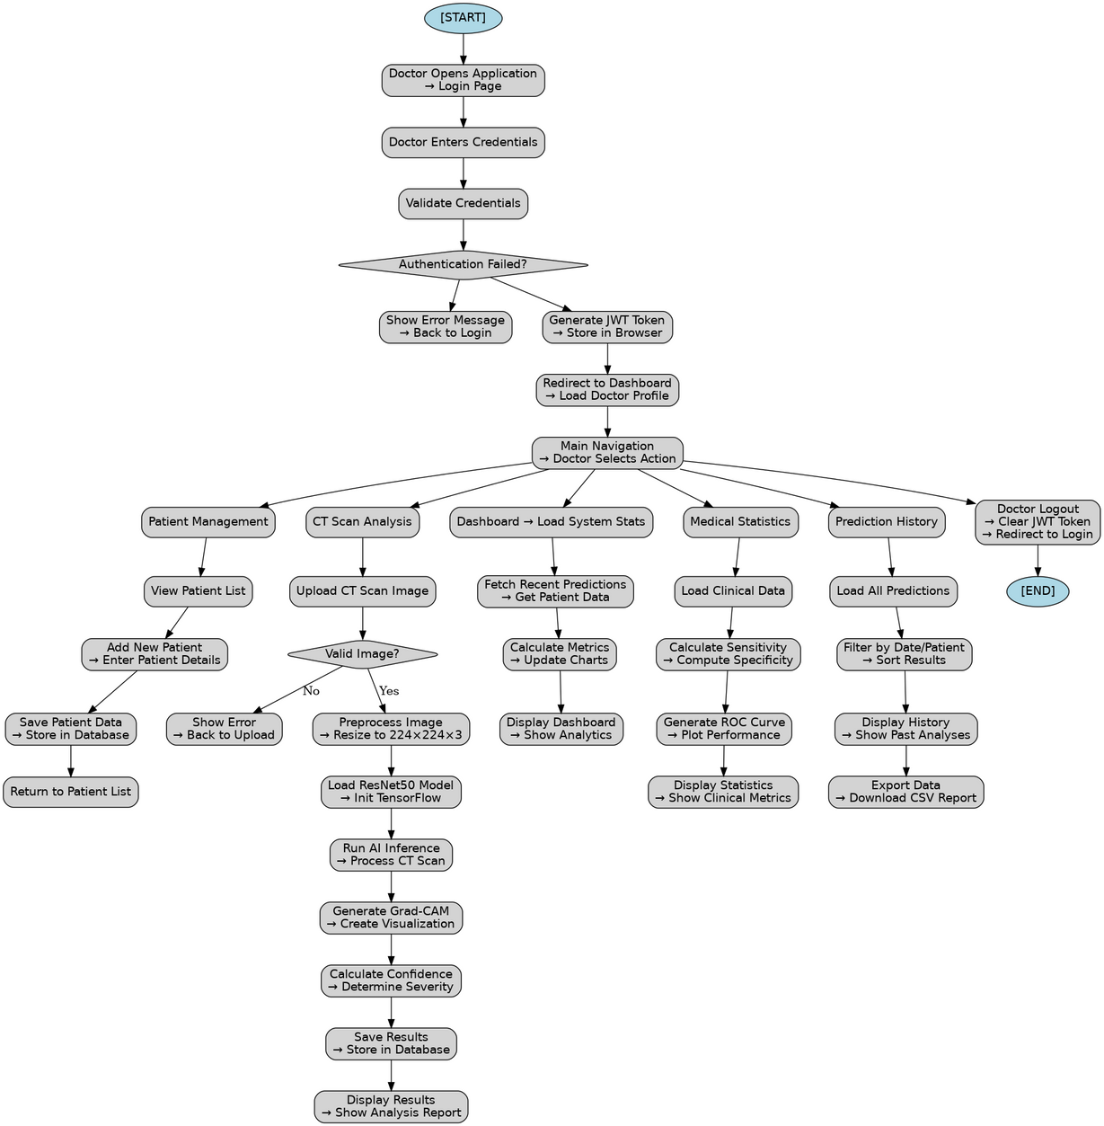
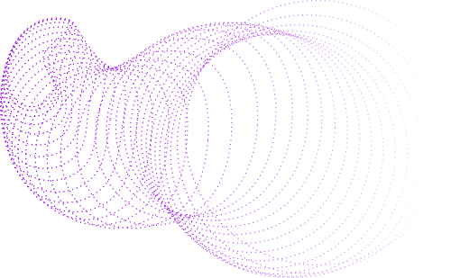
Technical Architecture Overview
Activity Diagram

Slide 6
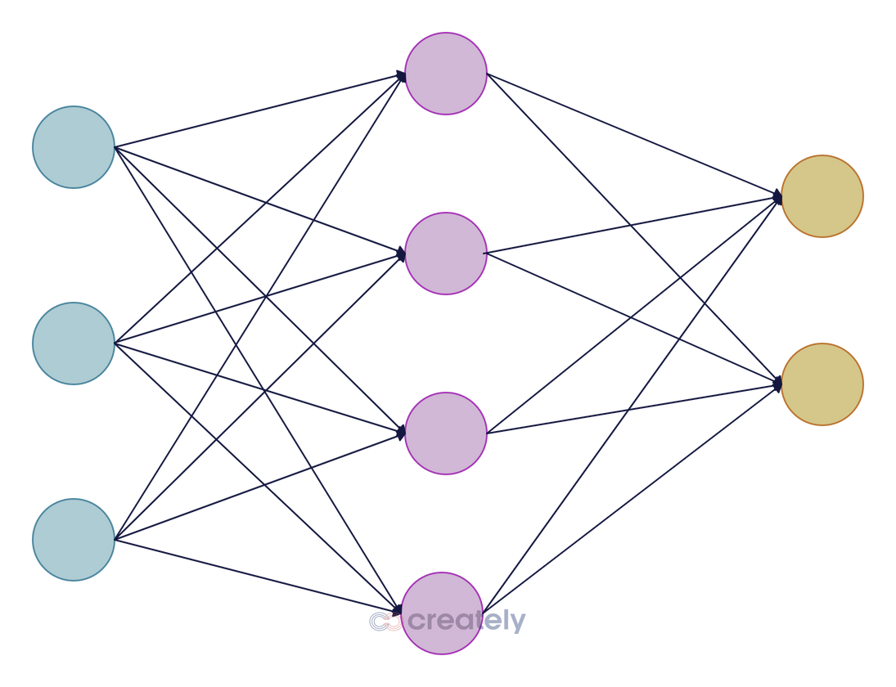
AI Model Architecture (ResNet50)
Model Architecture: ResNet50
50-layer deep residual neural network
Skip connections prevent vanishing gradients
Pre-trained on ImageNet (transfer learning)
Fine-tuned on 999 lung CT scans
Training Details:
Loss Function: Focal Loss (handles class imbalance)
Input Size: 224×224×3 pixel CT scans
Training Epochs: 20
Validation Accuracy: 86.9%
ROC AUC Score: 0.9956
Processing Time: <4 seconds per scan

Slide 7
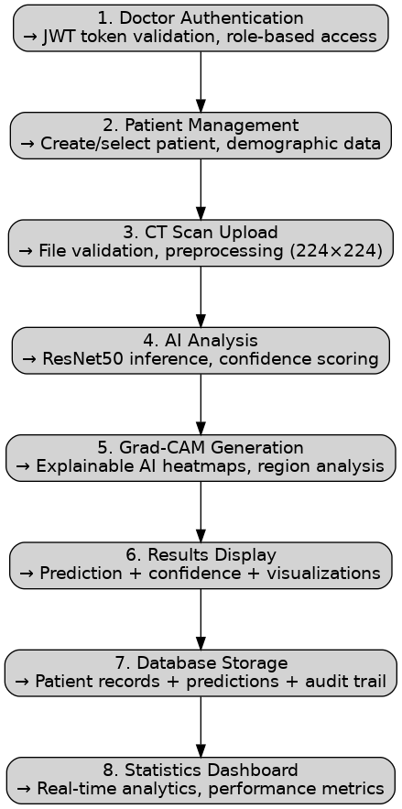
Complete System Workflow

Slide 8

Security & Database Design
Authentication & Security JWT tokens (8-hour expiry) Bcrypt password hashing Role-based access control (doctors) HIPAA-compliant data handling | Authentication & Security JWT tokens (8-hour expiry) Bcrypt password hashing Role-based access control (doctors) HIPAA-compliant data handling
Database Schema (PostgreSQL) Doctors: Medical staff credentials & profiles Patients: Demographic & medical information Predictions: AI results + Grad-CAM data Relationships: One-to-many (Patient → Predictions) | Database Schema (PostgreSQL) Doctors: Medical staff credentials & profiles Patients: Demographic & medical information Predictions: AI results + Grad-CAM data Relationships: One-to-many (Patient → Predictions)

Slide 9

System Performance
Processing Speed: <4 seconds per CT scan
Model Accuracy: 86.9% validation accuracy
Database Response: <100ms query times
Uptime: 99.9% availability
Scalability: Horizontal scaling ready
Clinical Impact
90% faster diagnosis than traditional methods
Early detection improves survival rates
Reduces diagnostic workload
24/7 availability for emergency cases
Comprehensive patient monitoring
Performance Metrics & Clinical Impact

Slide 10




Multi-modal analysis (X-ray, MRI)
Advanced analytics dashboard
Future Enhancements
AI chatbot with Grad-Cam Analysis
Thank You!

